Slide 1
KP ERROR 002 AND 003 INVESTIGATION
NOC: PRB -63 & PRB-67

Slide 2
Issue Definition
What We Know
Analysis
Investigations
Next steps
Conclusion

Slide 3
Issue Definition
There has been an increased number of KPs going out of service due to error code 002 (failed to open/close the dispense fuel safety valve) or error code 003 (failed to open/close the dispense air safety valve) over the last 3 months.
The problem has however been difficult to reproduce as the safety valves have opened and closed OK after the clearing of the fault state.

Slide 4
What We Know
8.6% of KPs have had error code 003 (55 out of 639) from 2/1/2020 to 3/18/2020 (slide 5)
9.1% of KPs have had error code 002 (58 out of 639) from 2/1/2020 to 3/18/2020 (slide 8)
NB: Data source - DB

Slide 5
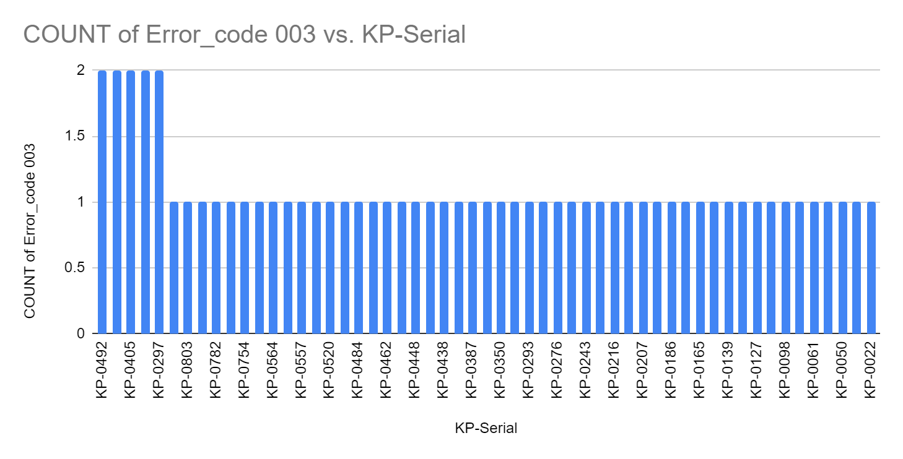
What We Know - Error 003

Slide 6
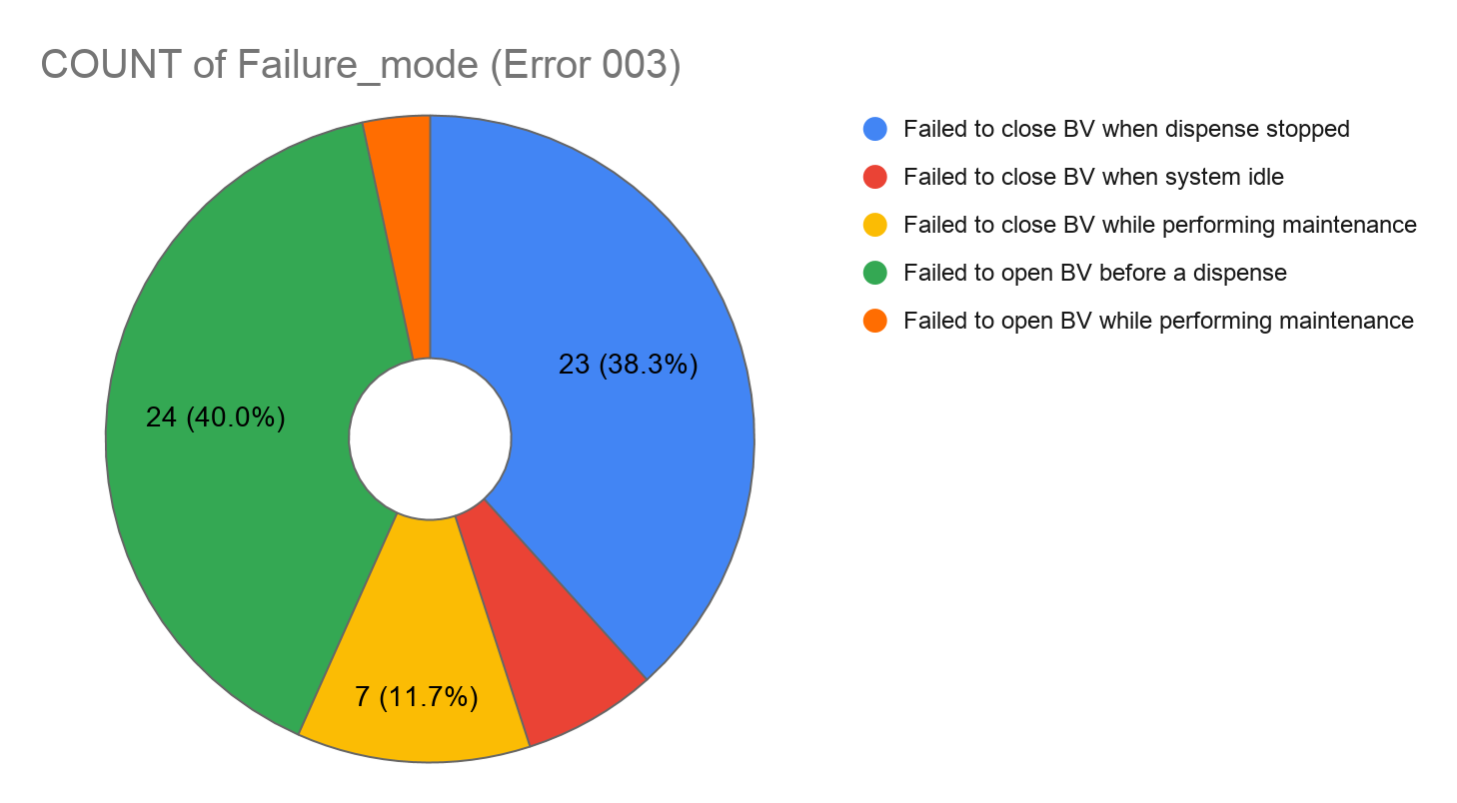
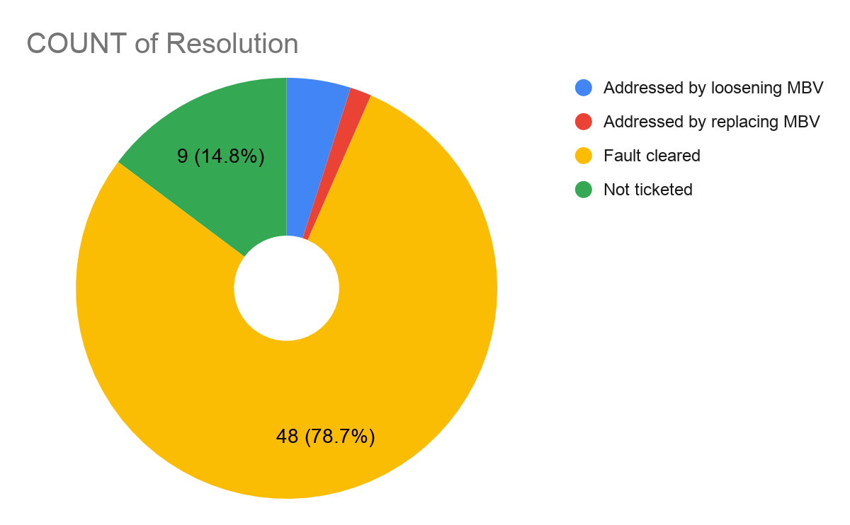
Error 003 - Failure Mode & Resolution Applied

Slide 7
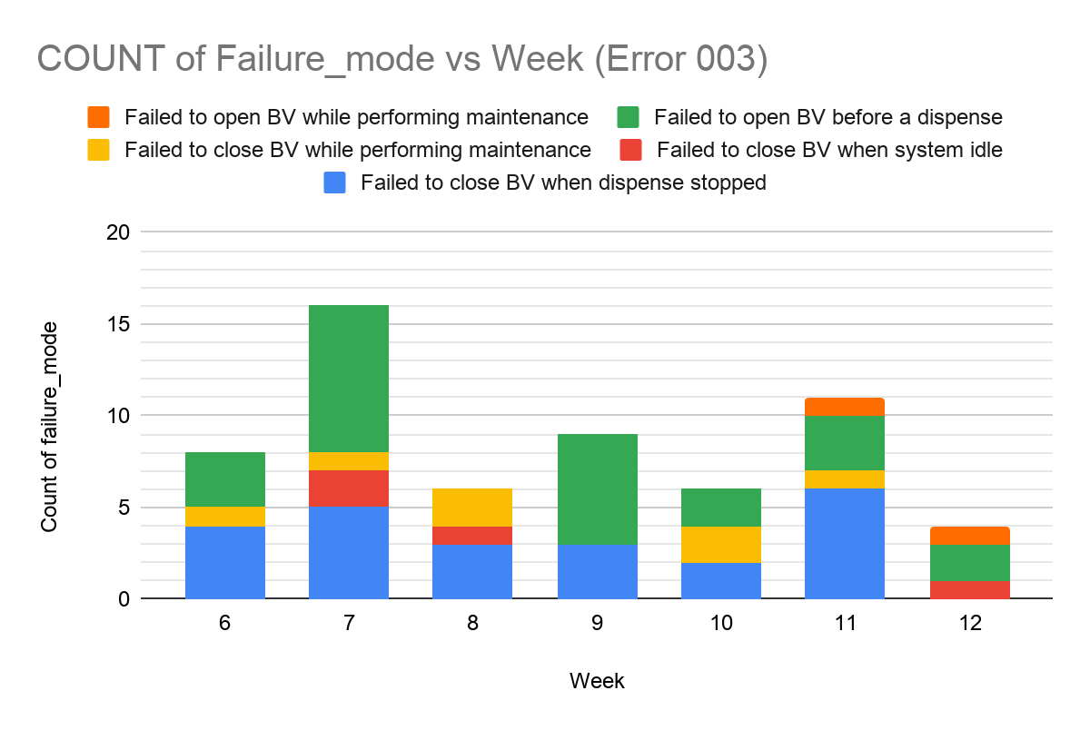
Error 003 Weekly Occurrences

Slide 8
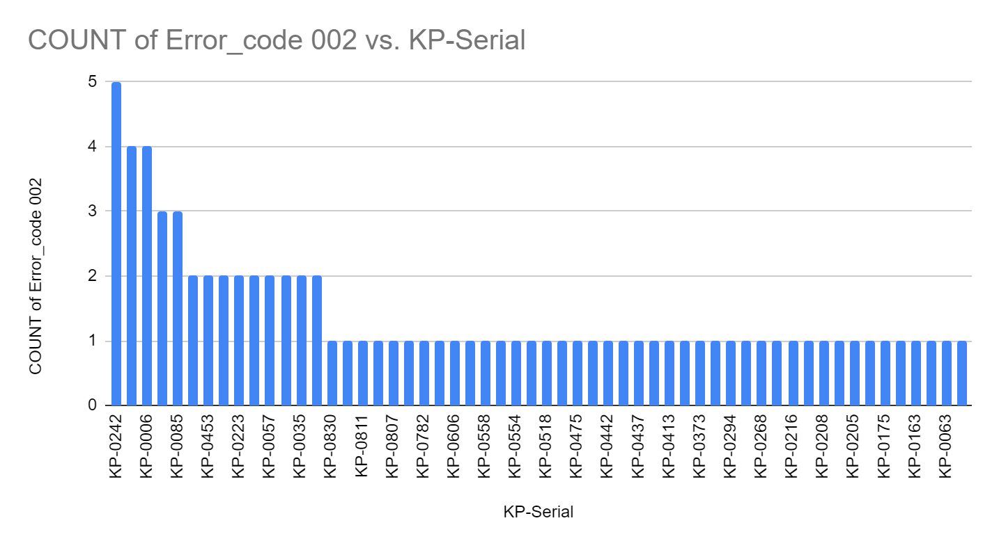
What We Know - Error 002

Slide 9
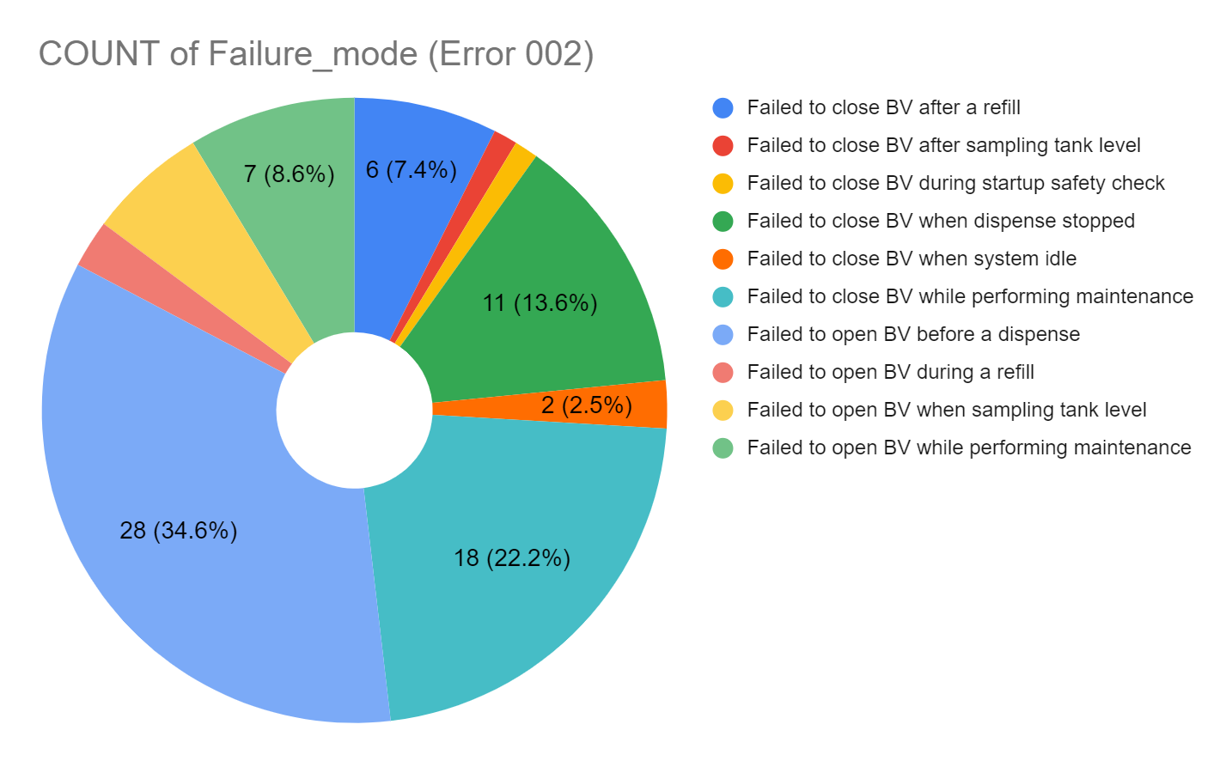
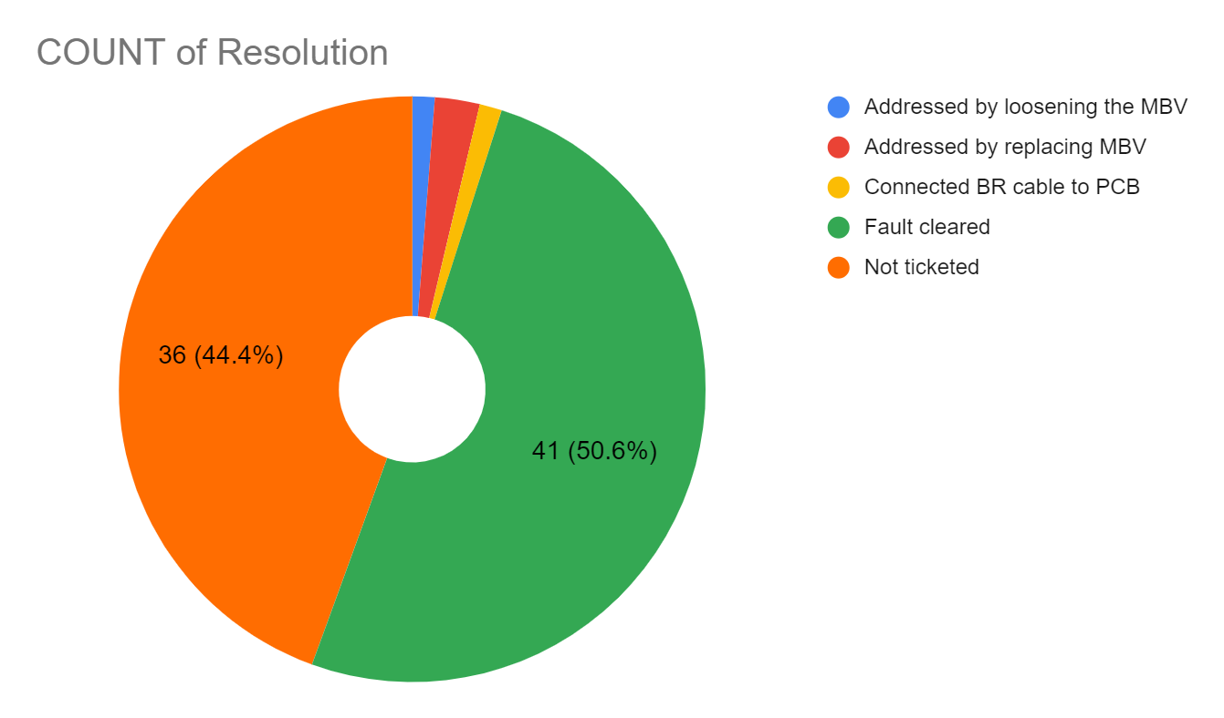
Error 002 - Failure Mode & Resolution Applied

Slide 10
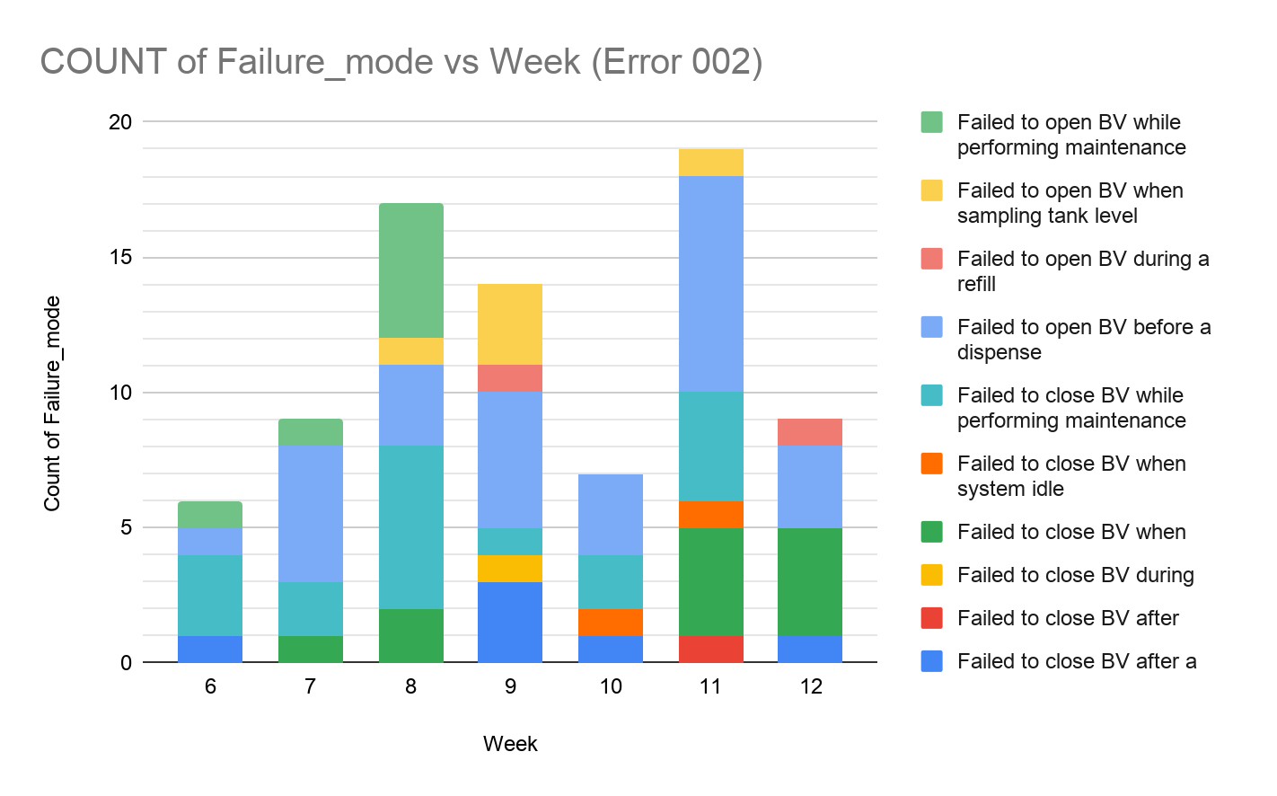
Error 002 Weekly Occurrences

Slide 11
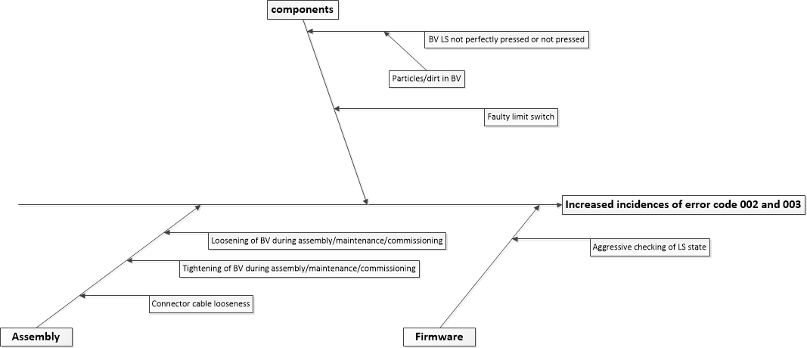
Error 002 and 003 Fishbone Analysis

Slide 12
Root Cause Prioritization Matrix
Error 002 and 003 Root Cause Prioritization Matrix
Root cause | Probability of occurrence | Severity level | Ease of detection | Cumulative scale
Faulty limit switch | 4 | 4 | 5 | 80
Particles/dirt in BV | 3 | 4 | 5 | 60
Loosening of BV during assembly/commissioning/maintenance causes PTFE seal to move and impede full limit switch contact | 2 | 4 | 5 | 40
Tightening of BV during assembly/commissioning/maintenance | 4 | 4 | 2 | 32
Connector cable looseness | 3 | 4 | 2 | 24
Aggressive checking of limit switch state | 1 | 4 | 1 | 4
 | Scale
 | Probability of occurrence | Severity Level | Ease of detection
1 | Impossible | Very Low | Very High
2 | Unlikely | Low | High
3 | Even Chance | Moderate | Moderate
4 | Likely | High | Low
5 | Certain | Very High | Very Low
The top 2 root causes to be investigated further:
Faulty limit switch
Particles/dirt in BV

Slide 13
Next Steps
Further investigations on faulty limit switches as the most likely cause of the problem currently ongoing after a software change was made (R35) to include limit switch debugging status messages.
This should enable detection and characterization of failure patterns
The initial results after R35 are available on slides 14 and 15

Slide 14
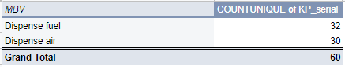
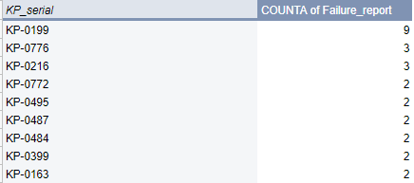
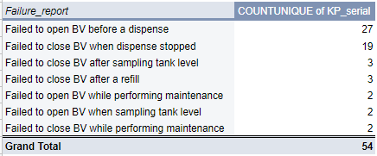
Distribution by KP Following R35
Summary of all MBV errors spanning 5/1/2020 to 5/18/2020 below:
Total KPs affected
KPs with > 1 faults
Count of KPs per Failure report
The remaining 51 KPs had a single issue each

Slide 15
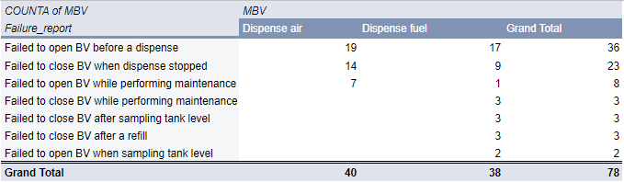
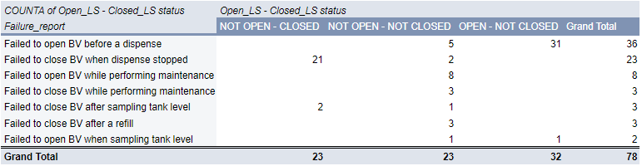
Distribution By MBV Following R35
Distribution of Failure report per MBV
Distribution of Limit Switch Status during Fault
The limit switch status for an open MBV should be OPEN-NOT CLOSED
The limit switch status for a closed MBV should be NOT OPEN-CLOSED
It immediately looks like the system is reporting false negatives (32 cases of failure to open and 23 cases of failure to close)
Brainstorming ongoing on how this could be so.
Of the remaining 23:
9 cases(failure to open) in KP-0199 during maintenance due to limit switch 1 staying closed
3 cases (failure to close) in KP-0776 during maintenance due to limit switch 2 staying closed.True for the remaining 11 cases

Slide 16
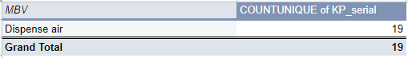
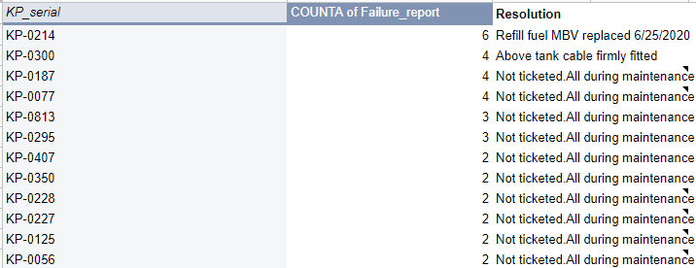
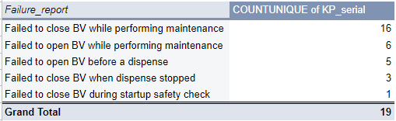
Distribution by KP Following R38
Summary of all MBV errors spanning 6/18/2020 to 7/3/2020 below:
Total KPs affected
KPs with > 1 faults
Count of KPs per Failure report
The remaining 7 KPs had a single issue each
All issues except the first 2 were due to

Slide 17
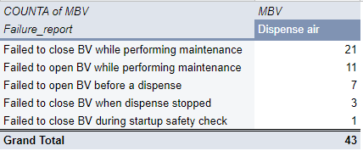
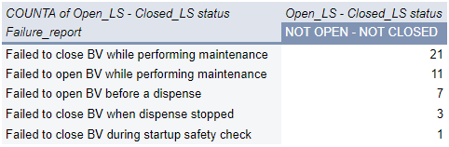
Distribution By MBV Following R38
Distribution of Failure report per MBV
Distribution of Limit Switch Status during Fault
The limit switch status for an open MBV should be OPEN-NOT CLOSED
The limit switch status for a closed MBV should be NOT OPEN-CLOSED
This new data indicates that the rampant error 002 and 003 may have been addressed by an introduction of a 100ms delay and secondary limit switch status check after MBV is de-energized
ALL the dispense air errors recorded in this period have been traced to MBVs being disconnected by technicians while troubleshooting MS-BS errors to allow built-up pressure escape the KP tank
The maintenance supervisors have since been advised to emphasize the use of the updated work instructions

Slide 18
Conclusion
Beyond the root cause analysis, faulty limit switches was picked as the most possible cause of the rampant errors. However, after modifying the firmware to include secondary checks (following initial high numbers of false negatives), the conclusion of this investigation is that aggressive checking of the limit switch status was the biggest contributor of the numerous error 002 and 003 alerts.

